Slide 1
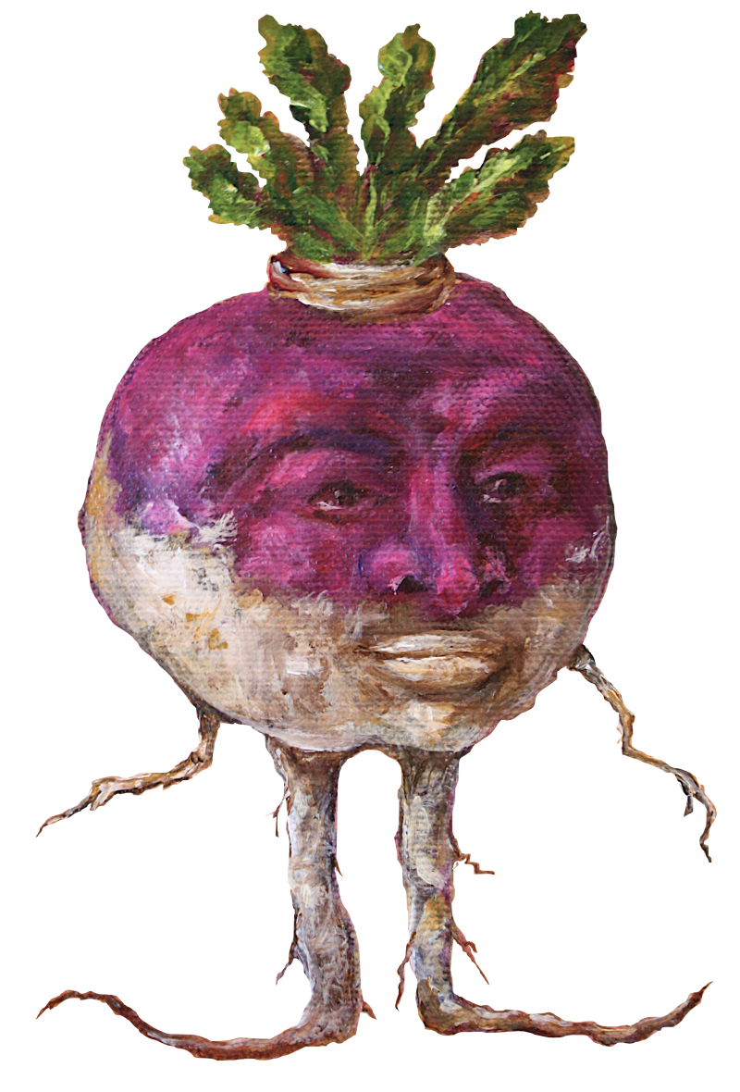
ImgHost
EZ
Team #8 - Turnip Taskforce
David Cruz, Eugene Jang, Christos Zervas

Slide 2
Description
EZImgHost is a simple image hosting site with simple step-by-step instructions so that any user can upload images to different categories and then view them later by browsing the images by categories.
Users can achieve this by :
Going to Upload page and selecting a category radio button
Choosing an image file from their computer
Going to Browse page and clicking on corresponding category page where the image was uploaded to

Slide 3
Functionality
Users could interact with the website in 2 main ways…
When arriving at the main page, the user will be greeted with a homepage that simply has a category to choose from and a box to upload an image. Upon uploading an image, they will be prompted with a message to navigate to the appropriate browse page to see the image.
The user can then navigate to the “browse” page where they can view categories of images. Upon selecting a category, they can see images that were uploaded in said category from least to most recently uploaded.
An ‘about’ page with the names, social medias, and short blurbs of information about the developers!

Slide 4
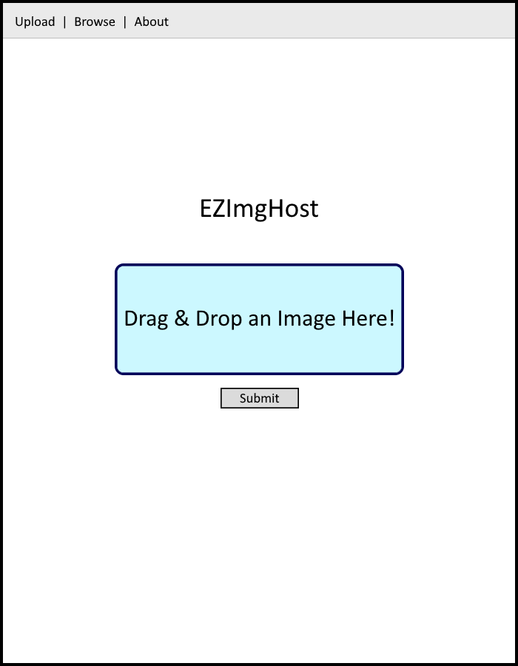
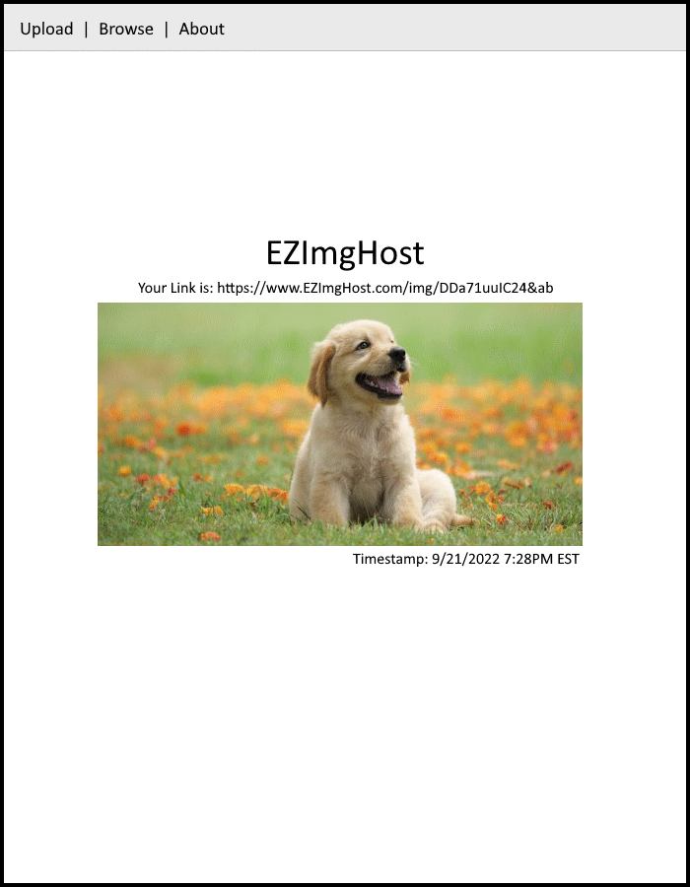
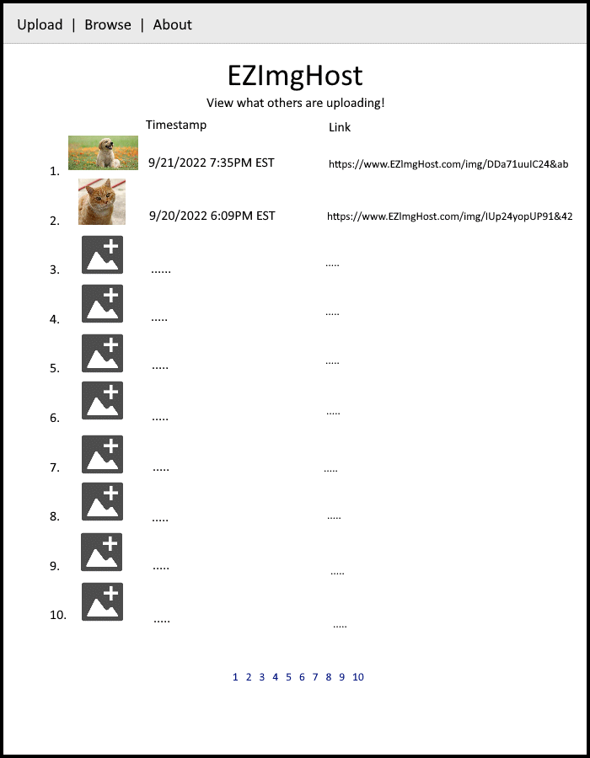
Preliminary Sketch
Home Page
Image Page
Browse Page

Slide 5
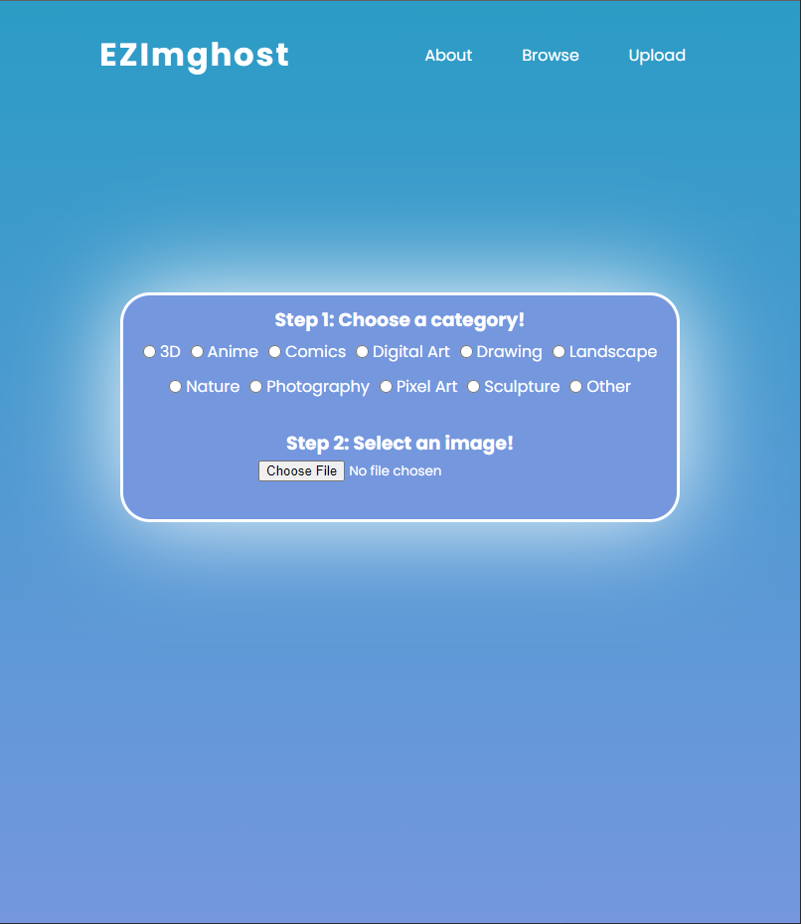
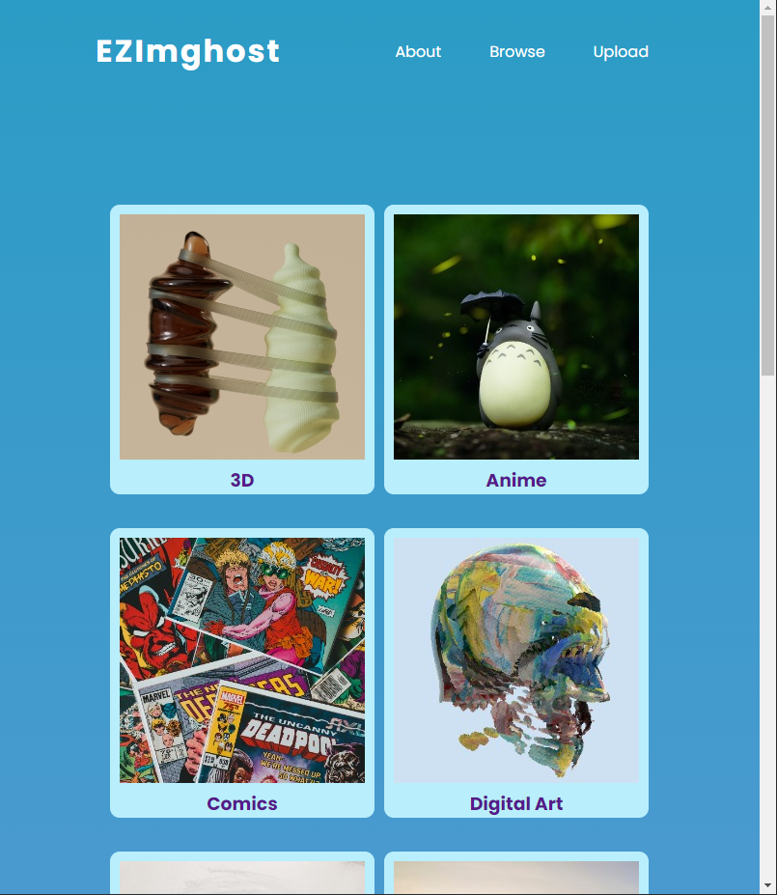
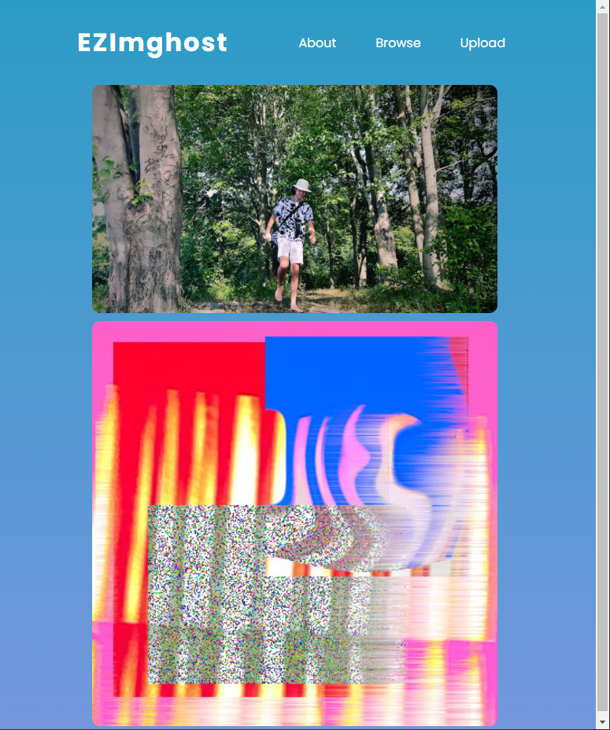
Website Design
Home Page
Browse Page
Category Page

Slide 6

Demo Video
https://youtu.be/LFTjJ-tpKDc

Slide 7

So, How did we do it?

Slide 8
First the backbone of any website: HTML Design
The main idea with our HTML was for all aspects of the site to be compartmentalized, easily recognizable, and expandable.
We did this by ensuring all aspects of each page were well structured/divided and giving IDs and classes to important elements.

Slide 9
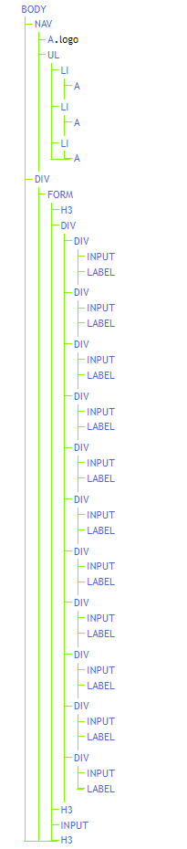
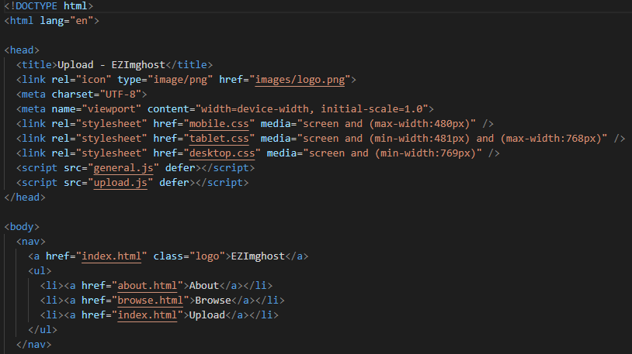
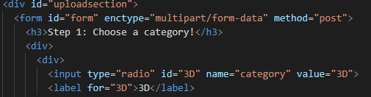
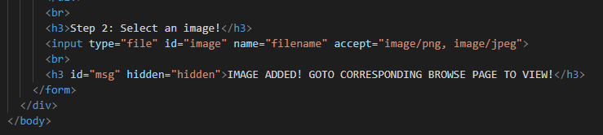
HTML DOMs (Home)

Slide 10
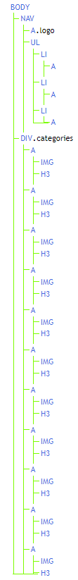
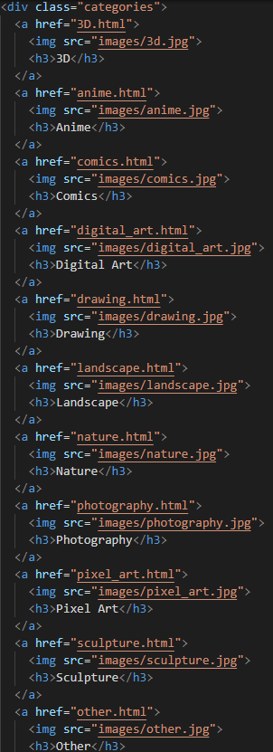
HTML DOMs (Browse)

Slide 11
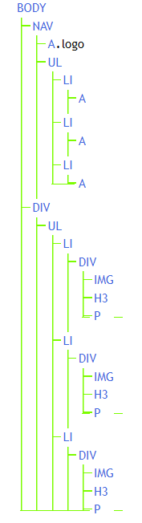
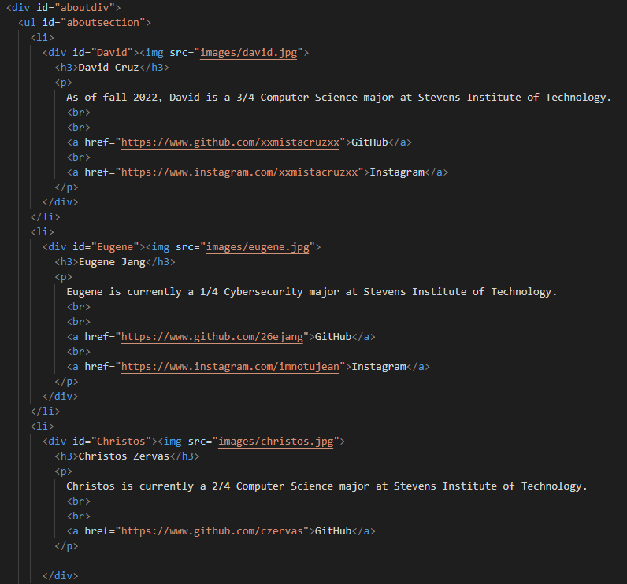
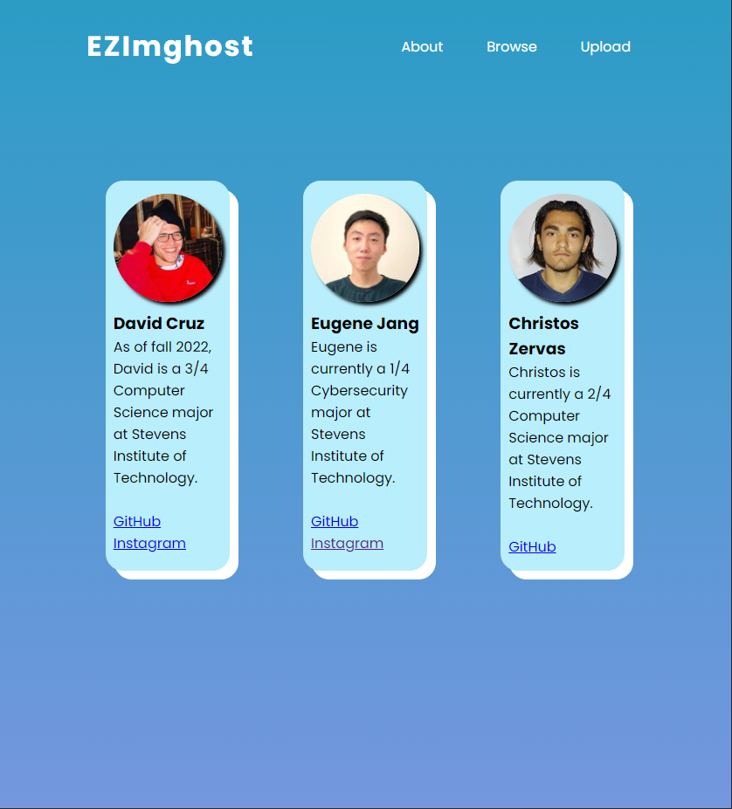
HTML DOMs (About)

Slide 12
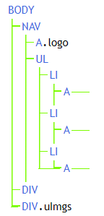
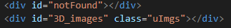
HTML DOMs (Category Page)

Slide 13
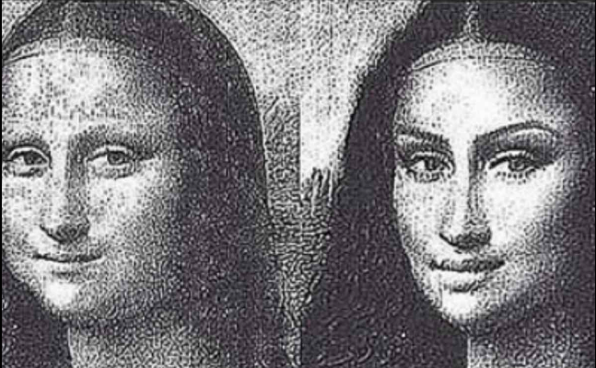
Next we give our site a makeover with CSS!
BEFORE AFTER

Slide 14
CSS Design
The CSS created was meant to be creative, yet traditional at the same time. We wanted to go for a unique looking site, but have the UI recognizable enough to be easily usable.
The CSS created has some dynamic aspects, such as the hover of elements on the browse page causing the UI to change color, and when you change window width, the order of the navigation bar elements change.
We decided to use the traditional desktop, tablet, and mobile CSS format to help our fluid design.

Slide 15

Last but not least, we gave our site a few features with JavaScript!

Slide 16
JS Design
Majority of the javascript written was used for the upload and displaying of uploaded images functionalities.
For these functionalities, it was vital to use selectors and listeners, localstorage, and DOM modification/insertion.
The remaining functionalities such as the navigation bar interactive CSS and about page image secret were done by using selectors, listeners, CSS insertions, and alerts.

Slide 17
Credits
HTML
David Cruz, Eugene Jang, Christos Zervas
CSS
David Cruz, Eugene Jang
JS
David Cruz, Eugene Jang
Presentation
David Cruz, Eugene Jang, Christos Zervas

Slide 18
Github
https://github.com/xxmistacruzxx/CS146DCEJCZ

